Slide 1
Entity-Relationship Model
1
E-R Diagrams

Slide 2
Purpose of E/R Model
The E/R model allows us to sketch the design of a database informally.
Designs are pictures called entity-relationship diagrams.
Fairly mechanical ways to convert E/R diagrams to real implementations like relational databases exist.

Slide 3
Entity Sets
Entity = “thing” or object.
Entity set = collection of similar entities.
Attribute = property of an entity set.
  Generally, all entities in a set have the same properties.
  Attributes are simple values, e.g. integers or character strings.

Slide 4
E/R Diagrams
In an entity-relationship diagram, each entity set is represented by a rectangle.
Each attribute of an entity set is represented by an oval, with a line to the rectangle representing its entity set.

Slide 5
Example
name
Adviser
Entity set Student has two attributes, name and Adviser.
Each Student entity has values for these two attributes, e.g. (Ahmad, Kazem)
Student

Slide 6
Relationships
A relationship connects two or more entity sets.
It is represented by a diamond, with lines to each of the entity sets involved.

Slide 7
Example
name
addr
name
code
Teachers
teaches
Courses
- Teachers are
teaching some
courses.
Number
- Students take
some courses.
Advises
Takes
- Teachers advises
some students.
Students
name
addr

Slide 8
Relationship Set
The current “value” of an entity set is the set of entities that belong to it.
  Example: the set of all students in our database.
The “value” of a relationship is a set of lists of currently related entities, one from each of the related entity sets.

Slide 9
Example
For the relationship Teaches, we might have a relationship set like:
Teachers Courses
Ahmad C++
Samir Math
Ahmad Java
Amer Internet
Samir Algorithms
Jaber Math
Ramez C++

Slide 10
Multiway Relationships
Sometimes, we need a relationship that connects more than two entity sets.
Suppose that students will only take certain courses taught by certain teachers.
  Our three binary relationships teaches, advises, and takes do not allow us to make this distinction.
  But a 3-way relationship would.

Slide 11
Example
name
addr
name
code
Teachers
Courses
number
Preferences
Students
name
addr

Slide 12
A Typical Relationship Set
Teacher Student Course
Ahmad Issam C++
Ahmad Nour C++
Ahmad Nour Java
Amer Issam Internet
Samir Samar Math
Samir Issam Math
Samir Nader Algorithms

Slide 13
Many-Many Relationships
Think of a relationship between two entity sets, such as Teaches between Teachers and Courses.
In a many-many relationship, an entity of either set can be connected to many entities of the other set.
  E.g., a teacher teaches many courses; a course is taught by many teachers.

Slide 14
In Pictures:
many-many

Slide 15

* Example of Many-Many Relationship
A customer is associated with several (possibly 0) loans via borrower
A loan is associated with several (possibly 0) customers via borrower

Slide 16
Many-One Relationships
Some binary relationships are many -one from one entity set to another.
Each entity of the first set is connected to at most one entity of the second set.
But an entity of the second set can be connected to zero, one, or many entities of the first set.

Slide 17
In Pictures:
many-one

Slide 18
Example
Advises, from Teachers to Students is One-Many.
A student has at most one adviser.
But a teacher can be the adviser of any number of students, including zero.

Slide 19

* Example of Many-One relationship
In a many-to-one relationship a loan is associated with several (including 0) customers via borrower, a customer is associated with at most one loan via borrower

Slide 20
One-One Relationships
In a one-one relationship, each entity of either entity set is related to at most one entity of the other set.
Example: Relationship Is-in between entity sets Teachers and Offices.
  A teacher cannot be in more than one office, and no office can have more than one teacher (assume this).

Slide 21
In Pictures:
one-one

Slide 22
* Example of One-One relationship
  -A customer is associated with at most one loan via the relationship borrower
  A loan is associated with at most one customer via borrower

Slide 23
Representing “Multiplicity”
Show a many-one relationship by an arrow entering the “one” side.
Show a one-one relationship by arrows entering both entity sets.

Slide 24
Example
Likes
Students
Courses
Favorite

Slide 25
Attributes on Relationships
Sometimes it is useful to attach an attribute to a relationship.
Think of this attribute as a property of tuples in the relationship set.

Slide 26
Example
Takes
Students
Course
Date
Date is a function of both the student and the course, not of one alone.

Slide 27
Roles
Sometimes an entity set appears more than once in a relationship.
Label the edges between the relationship and the entity set with names called roles.

Slide 28
Example
Relationship Set
Husband Wife
Bob Ann
Joe Sue
… …
Married
husband
wife
Teachers

Slide 29
Keys
A key is a set of attributes for one entity set such that no two entities in this set agree on all the attributes of the key.
  It is allowed for two entities to agree on some, but not all, of the key attributes.
We must designate a key for every entity set.

Slide 30
Keys in E/R Diagrams
Underline the key attribute(s).

Slide 31
Example: a Multi-attribute Key
dept
number
hours
room
Courses
Note that hours and room could also serve as a
key, but we must select only one key.

Slide 32
Keys
A super key of an entity set is a set of one or more attributes whose values uniquely determine each entity.
A candidate key of an entity set is a minimal super key
  Customer-id is candidate key of customer
  account-number is candidate key of account
Although several candidate keys may exist, one of the candidate keys is selected to be the primary key. Other candidate keys are alternate keys.

Slide 33
Weak Entity Sets
Occasionally, entities of an entity set need “help” to identify them uniquely.
Entity set E is said to be weak if in order to identify entities of E uniquely, we need to follow one or more many-one relationships from E and include the key of the related entities from the connected entity sets.

Slide 34
Example
name is almost a key for football players, but there might be two with the same name.
number is certainly not a key, since players on two teams could have the same number.
But number, together with the Team related to the player by Plays-on should be unique.

Slide 35
In E/R Diagrams
name
number
name
--------
Players
Plays-
on
Teams
Double diamond for supporting many-one relationship.
Double rectangle for the weak entity set.

Slide 36
Weak Entity-Set Rules
A weak entity set has one or more many-one relationships to other (supporting) entity sets.
  Not every many-one relationship from a weak entity set need be supporting.
The key for a weak entity set is its own underlined attributes and the keys for the supporting entity sets.
  E.g., player-number and team-name is a key for Players in the previous example.

Slide 37
Weak Entity-Set (Cont.)
An entity set that does not have a primary key is referred to as a weak entity set.
The existence of a weak entity set depends on the existence of a identifying entity set
  it must relate to the identifying entity set via a total, one-to-many relationship set from the identifying to the weak entity set
  Identifying relationship depicted using a double diamond
The discriminator (or partial key) of a weak entity set is the set of attributes that distinguishes among all the entities of a weak entity set.
The primary key of a weak entity set is formed by the primary key of the strong entity set on which the weak entity set is existence dependent, plus the weak entity set’s discriminator.

Slide 38
Weak Entity Sets (Cont.)
Note: the primary key of the strong entity set is not explicitly stored with the weak entity set, since it is implicit in the identifying relationship.
If loan-number were explicitly stored, payment could be made a strong entity, but then the relationship between payment and loan would be duplicated by an implicit relationship defined by the attribute loan-number common to payment and loan

Slide 39

Weak Entity Sets (Cont.)
We depict a weak entity set by double rectangles.
We underline the discriminator of a weak entity set with a dashed line.
payment-number – discriminator of the payment entity set
Primary key for payment – (loan-number, payment-number)

Slide 40
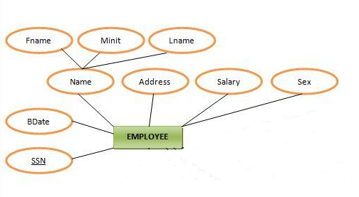
Some types of attributes - Composite
Composite attribute is an attribute that is composed of several attributes

Slide 41
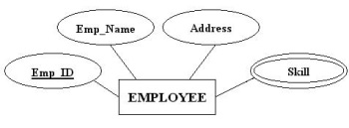
Some types of attributes - Multivalued
Multivalued attribute is an attribute that can have more than one value at a time

Slide 42
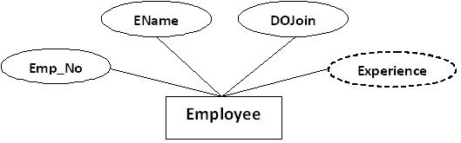
Some types of attributes -Derived
Derived attribute is an attribute whose value is calculated (derived) from other attributes

Slide 43
Enhanced Entity-Relationship Model

Slide 44
Enhanced-ER (EER) Model Concepts
Includes all modeling concepts of basic ER.
Additional concepts: subclasses/super classes, specialization/generalization, categories, attribute inheritance.
The resulting model is called the enhanced-ER or Extended ER (E2R or EER) model.
It is used to model applications more completely and accurately if needed.
It includes some object-oriented concepts, such as inheritance.

Slide 45
Subclasses and Super classes (1)
An entity type may have additional meaningful sub groupings of its entities.
Example: EMPLOYEE may be further grouped into SECRETARY, ENGINEER, MANAGER, TECHNICIAN, SALARIED_EMPLOYEE, HOURLY_EMPLOYEE,…
  Each of these groupings is a subset of EMPLOYEE entities.
  Each is called a subclass of EMPLOYEE.
  EMPLOYEE is the superclass for each of these subclasses.
These are called superclass/subclass relationships.
Example: EMPLOYEE/SECRETARY, EMPLOYEE/TECHNICIAN.

Slide 46
Subclasses and Super classes (2)
These are also called IS-A relationships (SECRETARY IS-A EMPLOYEE, TECHNICIAN IS-A EMPLOYEE, …).
Note: An entity that is member of a subclass represents the same real-world entity as some member of the super class.
  The Subclass member is the same entity in a distinct specific role.
  An entity cannot exist in the database merely by being a member of a subclass; it must also be a member of the super class.
  A member of the super class can be optionally included as a member of any number of its subclasses.
Example: A salaried employee who is also an engineer belongs to the two subclasses ENGINEER and SALARIED_EMPLOYEE.
  It is not necessary that every entity in a super class be a member of some subclass.

Slide 47
Attribute Inheritance
An entity that is member of a subclass inherits all attributes of the entity as a member of the super class.
It also inherits all relationships.

Slide 48
Specialization
Top-down design process; we designate sub groupings within an entity set that are distinctive from other entities in the set.
These sub groupings become lower-level entity sets that have attributes or participate in relationships that do not apply to the higher-level entity set.
Is the process of defining a set of subclasses of a super class.
The set of subclasses is based upon some distinguishing characteristics of the entities in the super class.

Slide 49
Specialization
Example: {SECRETARY, ENGINEER, TECHNICIAN} is a specialization of EMPLOYEE based upon job type.
  May have several specializations of the same super class.
Example: Another specialization of EMPLOYEE based in method of pay is {SALARIED_EMPLOYEE, HOURLY_EMPLOYEE}.
  Super class/subclass relationships and specialization can be diagrammatically represented in EER diagrams.
  Attributes of a subclass are called specific attributes. For example, TypingSpeed of SECRETARY.
  The subclass can participate in specific relationship types. For example, BELONGS_TO of HOURLY_EMPLOYEE.

Slide 50
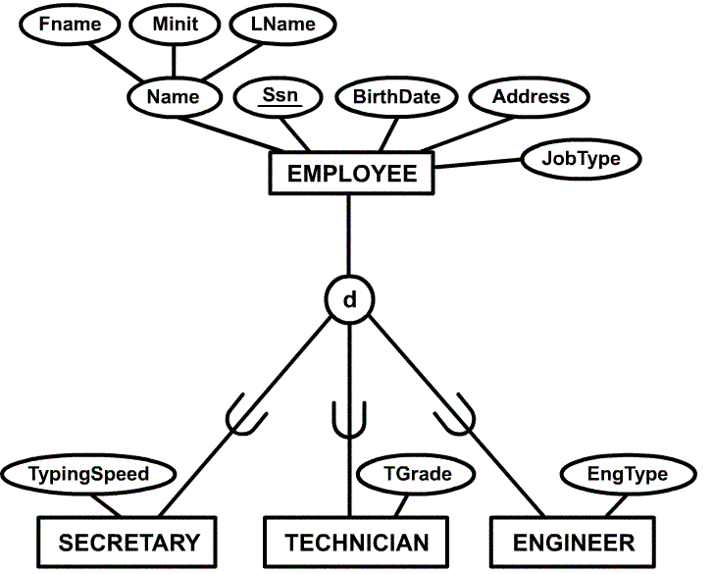
Example of a Specialization

Slide 51
Generalization
The reverse of the specialization process.
Several classes with common features are generalized into a super class; original classes become its subclasses.
Example: CAR, TRUCK generalized into VEHICLE; both CAR, TRUCK become subclasses of the super class VEHICLE.
  We can view {CAR, TRUCK} as a specialization of VEHICLE.
  Alternatively, we can view VEHICLE as a generalization of CAR and TRUCK.

Slide 52
Generalization and Specialization
Data Modeling with Specialization and Generalization
  A super class or subclass represents a set of entities.
  Shown in rectangles in EER diagrams (as are entity types).
  Sometimes, all entity sets are simply called classes, whether they are entity types, super classes, or subclasses.

Slide 53
Constraints on Specialization and Generalization
Two other conditions apply to a specialization/generalization:
Disjointness Constraint:
  Specifies that the subclasses of the specialization must be disjointed (an entity can be a member of at most one of the subclasses of the specialization).
  Specified by d in EER diagram.
  If not disjointed, overlap; that is the same entity may be a member of more than one subclass of the specialization.
  Specified by o in EER diagram.
Completeness Constraint:
  Total specifies that every entity in the super class must be a member of some subclass in the specialization/ generalization.
  Shown in EER diagrams by a double line.
  Partial allows an entity not to belong to any of the subclasses.
  Shown in EER diagrams by a single line.

Slide 54
Constraints on Specialization and Generalization
Hence, we have four types of specialization/generalization:
  Disjoint, total
  Disjoint, partial
  Overlapping, total
  Overlapping, partial
Note: Generalization usually is total because the super class is derived from the subclasses.

Slide 55
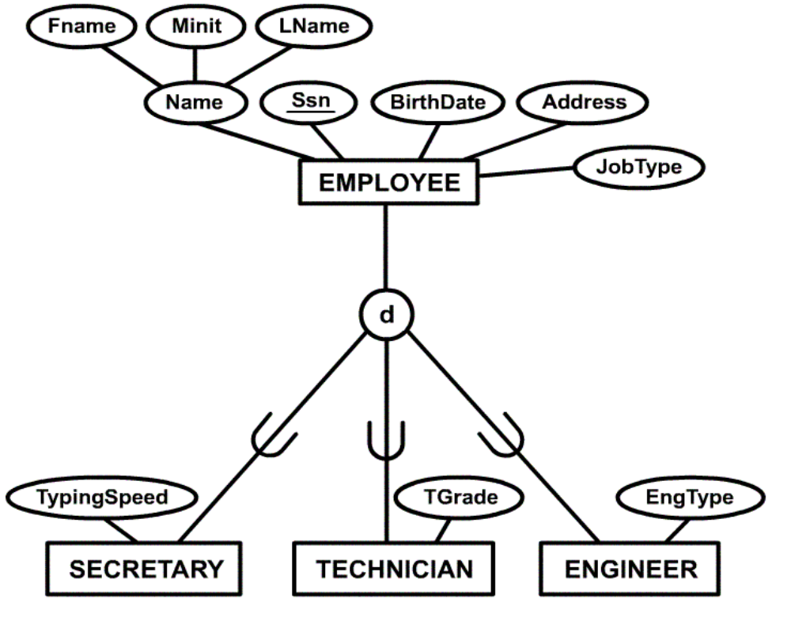
Example of Partial-Disjoint Specialization

Slide 56
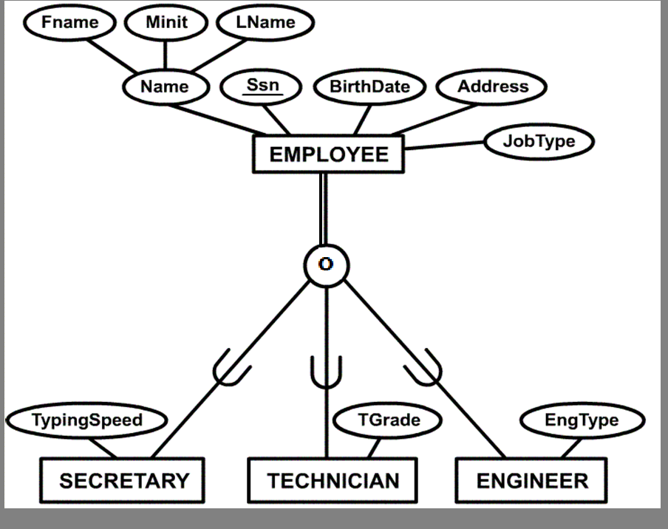
Example of Total-Overlap Specialization

Slide 57
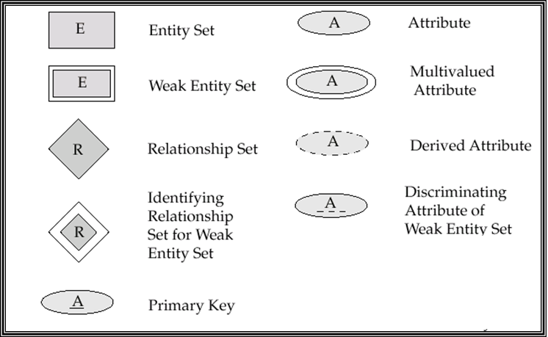
Summary of Symbols Used in E-R Notation

Slide 58

Summary of Symbols (Cont.)

Slide 59

Alternative E-R Notations

Slide 60
END

